Slide 1
Secure Data Hiding in Images using Steganography
CAPSTONE PROJECT
Presented By:
Student Name : Aruna S
College Name : BMS Institute of Technology and Management
Department: MTech – Cyber Security

Slide 2
OUTLINE
Problem Statement
Technology used
Wow factor
End users
Result
Conclusion
Git-hub Link
Future scope

Slide 3
Problem Statement
With growing concerns over data privacy, traditional encryption alone may not be enough. This project uses steganography to hide secret messages within images, making them invisible to unauthorized users. A password-based system ensures only intended recipients can encode and decode the hidden data, enhancing secure communication.

Slide 4
Technology used
Technologies Used:
Programming Language: Python
Platform: Windows (Using Tkinter for GUI)
Libraries and Frameworks
Tkinter- For building the graphical user interface(GUI)
PIL (Pillow) – For opening, processing, and displaying images
OpenCV (cv2) – For image manipulation, encoding, and decoding hidden data
os - For handling file operations and managing directories.
numpy – For efficient pixel manipulation in images.

Slide 5
Wow factors
What makes this steganography project stand out is its dual-layer security, combining password protection with image-based encryption, ensuring that only authorized users can decode hidden messages.
Unlike traditional encryption, which is easily recognizable, this method seamlessly hides data within images without visible distortion, preserving image quality.
The user-friendly Tkinter-based GUI makes encryption and decryption accessible to non-technical users, while support for multiple image formats like PNG, JPEG, and BMP adds flexibility.
Additionally, this project is lightweight and works offline, ensuring end-to-end confidentiality without relying on external servers, making it ideal for secure and private communication.

Slide 6
End users
The primary end users of this steganography project include:
Cybersecurity Professionals – For secure data transmission and covert communication.
Journalists & Activists – To protect sensitive information from surveillance and censorship.
Government & Military Personnel – For secure and confidential exchange of critical data.
Students & Researchers – For learning and experimenting with data security techniques.
General Users – Anyone looking to privately share information without raising suspicion.
This tool is ideal for individuals and organizations that require secure, hidden communication without relying on traditional encryption methods.

Slide 7
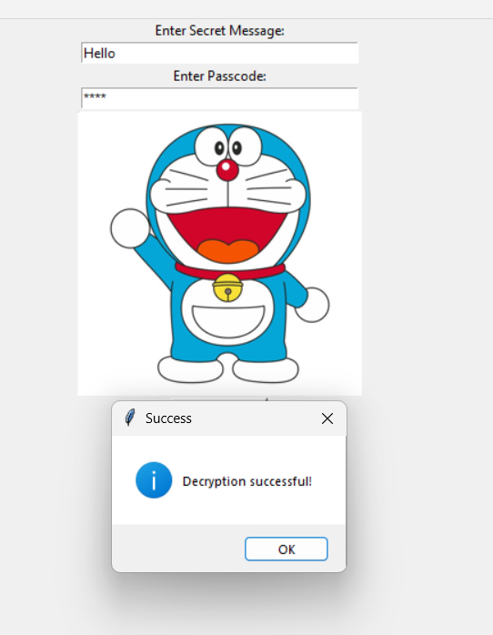
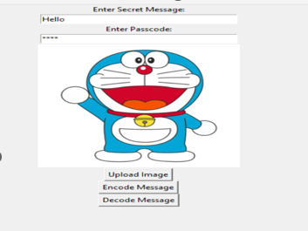
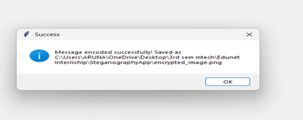
Results
Fig 1: Encode Message Fig 2: Message encoded Successfully Fig 3: Decryption Successful

Slide 8
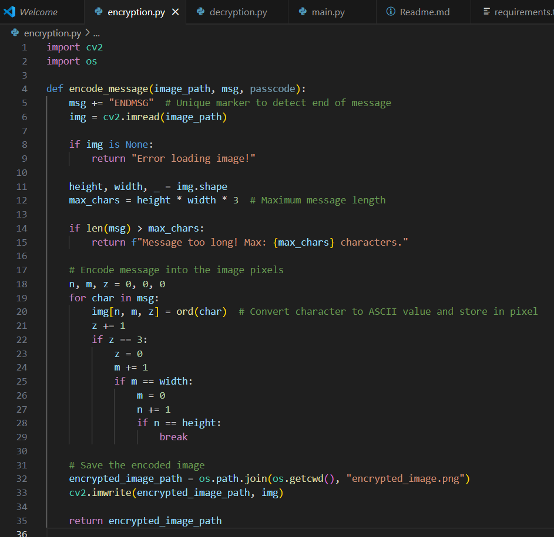
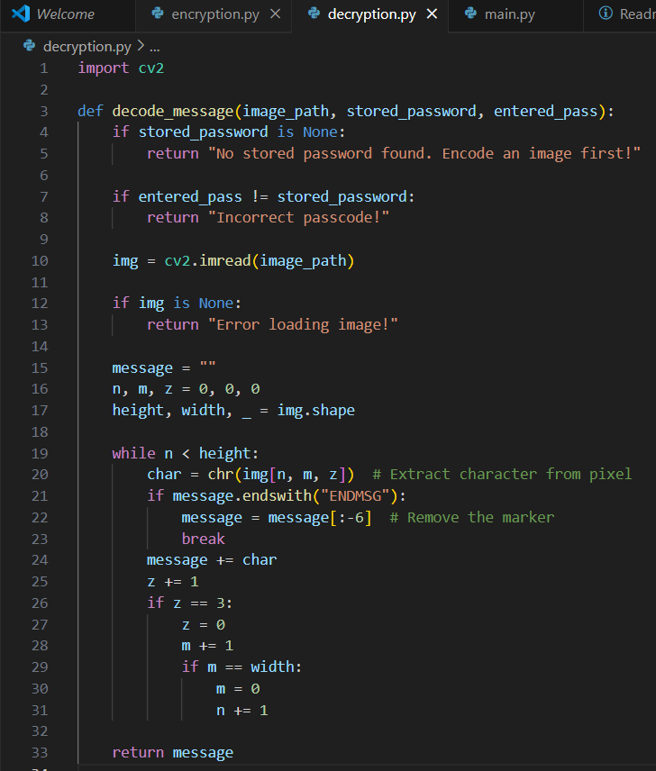
Results
Fig 4: Encryption Snippet Fig 5: Decryption Snippet

Slide 9
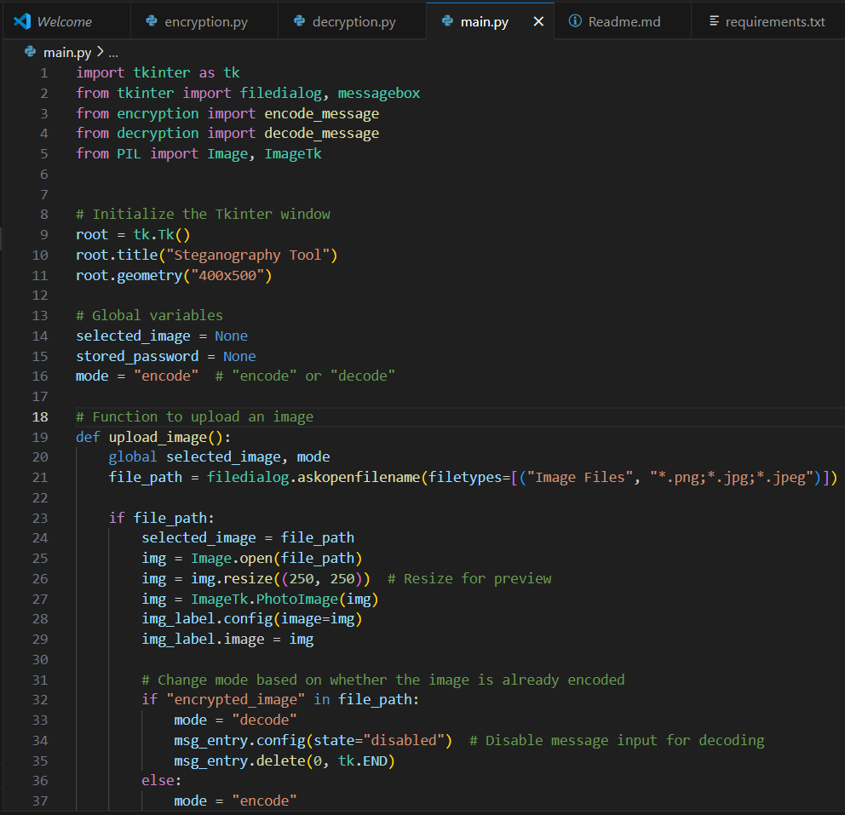
Results
Fig 6: Main.py Snippet

Slide 10
Conclusion
The "Secure Data Hiding in Images using Steganography" project successfully addresses the need for secure communication by embedding confidential messages within images. By utilizing steganographic techniques, the project ensures that sensitive information remains hidden from unauthorized users while maintaining the original image's appearance. The use of encryption further enhances security, preventing unauthorized access even if the encoded image is intercepted. With a user-friendly interface, password-protected encoding and decoding, and seamless image processing, this project provides a practical and efficient solution for secure data transmission.

Slide 11
GitHub Link
https://github.com/Aruna-200/Secure-Data-Hiding-in-Images-using-Steganography

Slide 12
Future scope
The Secure Data Hiding in Images using Steganography project has significant potential for further enhancements and applications. Future improvements could include integrating more robust encryption algorithms for added security, supporting multiple image formats, and developing mobile and web-based versions for wider accessibility. Additionally, implementing AI-based steganalysis detection prevention techniques can further enhance the system’s resistance against attacks. The project can also be extended for secure watermarking, digital forensics, and secure document transmission, making it highly relevant for government, corporate, and personal security applications.

Slide 13
THANK YOU

